Slide 1
Kenya’s Biodiversity in GBIF: The Good, the Gaps, the Path Forward
Jean K · Kwiz Computing Technologies

Slide 2


Slide 3
Why this study?
Kenya’s biodiversity is legendary.
But how much of it is actually visible in open data?
Based on 4.9M GBIF records, this reveals how sampling shapes what we think we know.

Slide 4
Scope of Data
Uses ONLY GBIF-mediated open-access data for Kenya.
Excludes national datasets (KWS, WRTI, NMK, universities, conservancies).
This is “Kenya through the GBIF window”, not a full inventory.

Slide 5
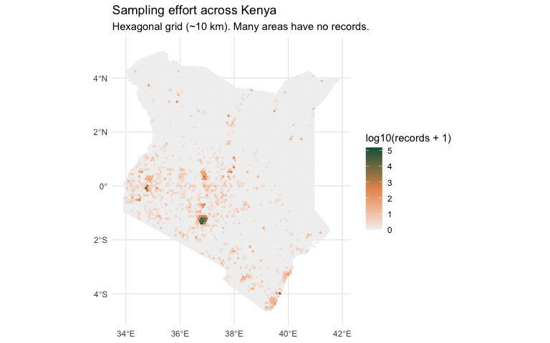
Discovery 1 — Limited Coverage
Only 13.3% of Kenya has any biodiversity records in GBIF.

Slide 6
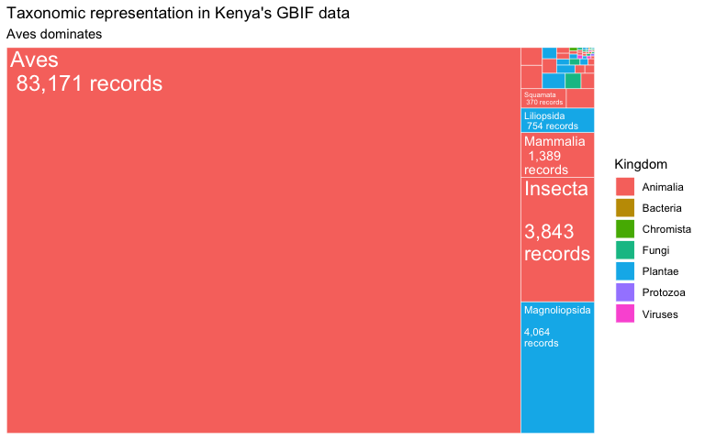
Discovery 2 — Taxonomic Bias
87.5% of all records are birds.

Slide 7
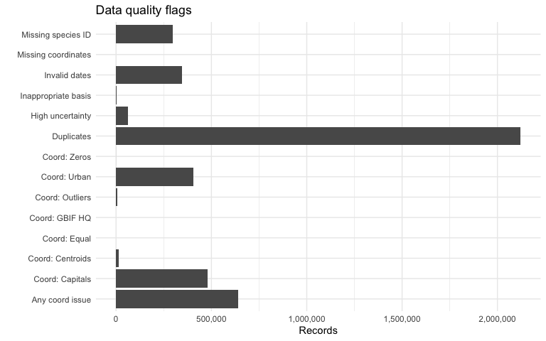
Discovery 3 — Data Quality Issues

Slide 8
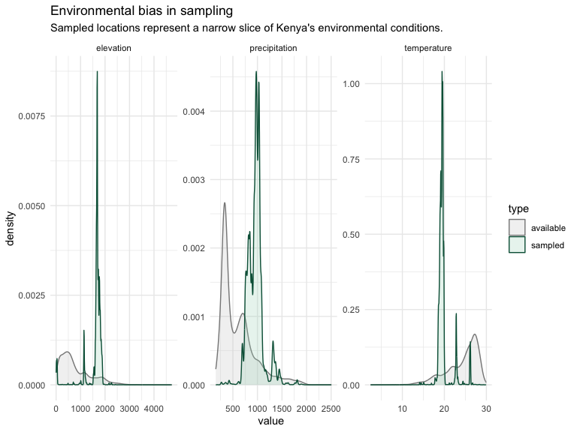
Discovery 4 — Environmental Bias

Slide 9
Implications for Kenya
Gaps form a roadmap for:
Strategic biodiversity surveys
Bias-aware modelling
Better conservation planning
Helps distinguish “species absent” from “species unsampled”.

Slide 10
Vision 2030 Alignment
Vision 2030 calls for:
Mapping wildlife hotspots
Enhancing ecological monitoring
Developing a national wildlife database at KWS HQ
This GBIF baseline complements national data systems.

Slide 11
Global Context
Findings mirror global patterns described by: - Meyer et al. (2015) - Beck et al. (2014) - Oliver et al. (2021) - Hughes (2021)

Slide 12
Conclusion
Kenya’s biodiversity is richer than open data suggests. Understanding what is missing strengthens research, policy and conservation decisions.
Read the full analysis on GBIF Data Quality Assessment here

Slide 13
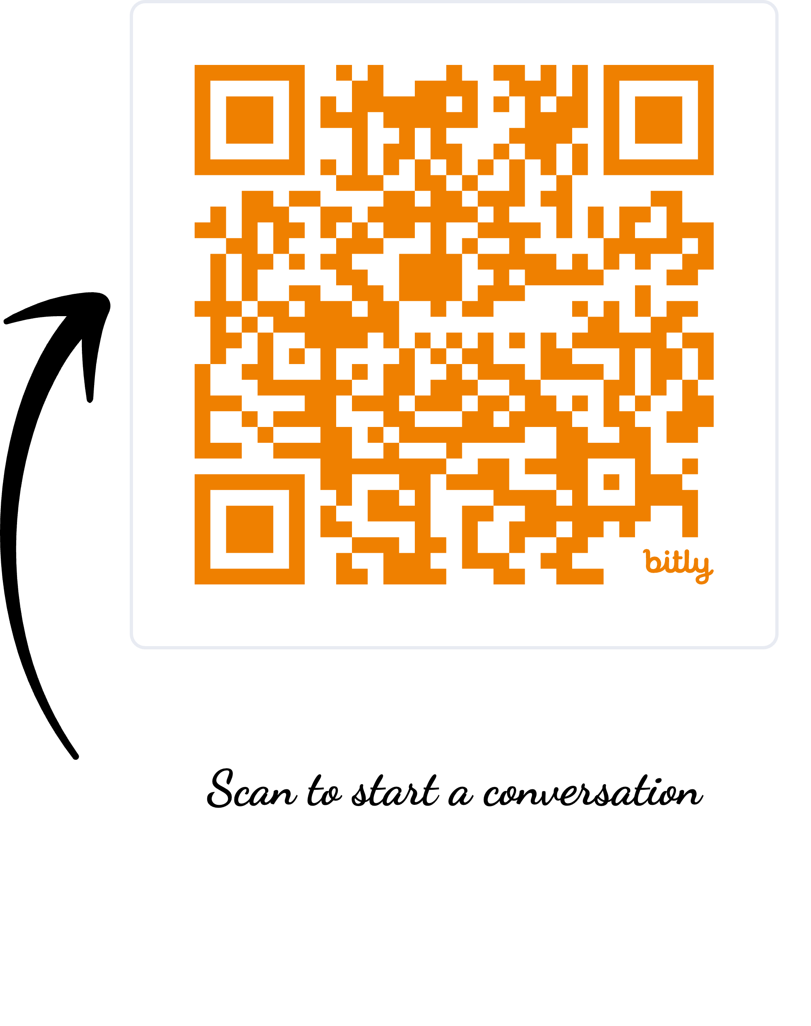
Scan to Start the Conversation
Kwiz Computing Technologies helps organizations build high-integrity, scalable, decision-ready data solutions biodiversity and climate analytics solutions.
From data quality pipelines to advanced modelling and interactive dashboards, we support research, policy and enterprise needs across Africa and beyond.

